Slide 1
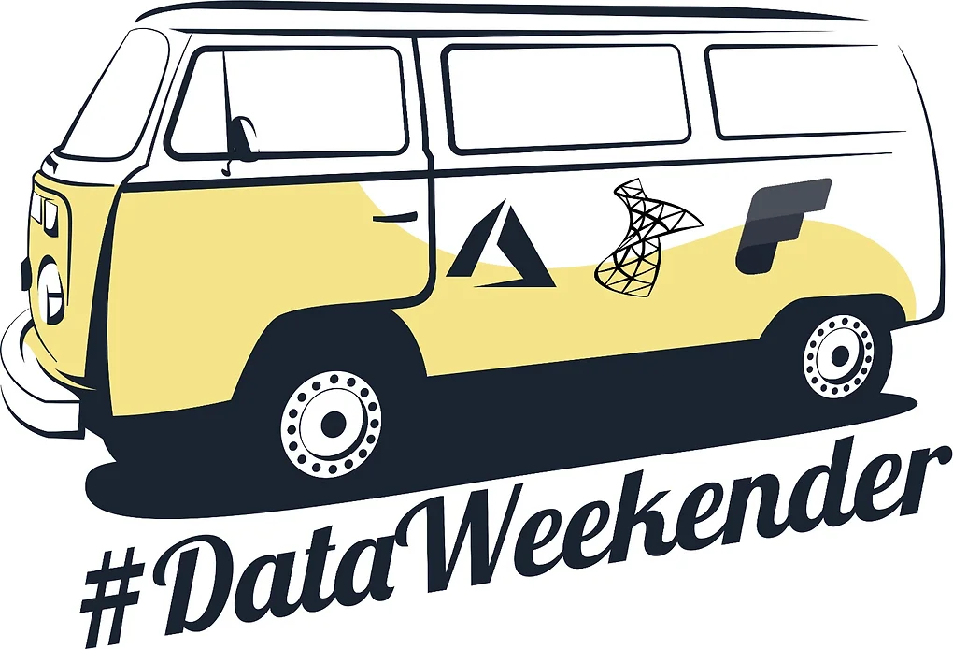
Data mesh, data product, data WTF
Using Microsoft Fabric
Tom Martens @ Data Weekender 6.5
2023-11-04

Slide 2
Inside the box
Who I am
New concepts, or only new names?
How Microsoft Fabric can help, or can it not?

Slide 3


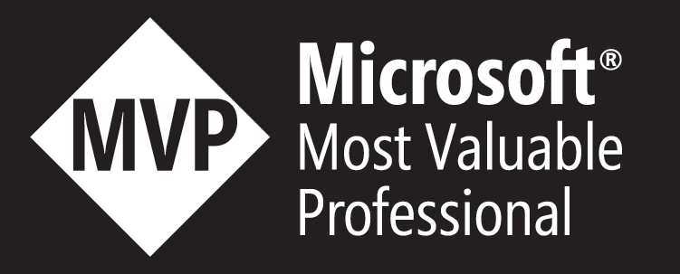
Tom Martens
25+ years of experience designing analytical solutions using the MSFT data platform
Solution Architect @ Munich Re
/tommartens68
@tommartens68

Slide 4

New Concepts/ Technologies (starting with a recap)

Slide 5
A little recap, or back to the present (maybe)
Before we delve into new concepts, lets take some time and ponder about this thing called Data Warehouse:
In computing, a data warehouse (DW or DWH), also known as an enterprise data warehouse (EDW), is a system used for reporting and data analysis and is considered a core component of business intelligence. Data warehouses are central repositories of integrated data from one or more disparate sources. They store current and historical data in one single place that are used for creating analytical reports for workers throughout the enterprise. This is beneficial for companies as it enables them to interrogate and draw insights from their data and make decisions.
https://en.wikipedia.org/wiki/Data_warehouse

Slide 6
A little recap, or back to the present (maybe)
Before we delve into new concepts, lets take some time and ponder about this thing called Data Warehouse:
In computing, a data warehouse (DW or DWH), also known as an enterprise data warehouse (EDW), is a system used for reporting and data analysis and is considered a core component of business intelligence. Data warehouses are central repositories of integrated data from one or more disparate sources. They store current and historical data in one single place that are used for creating analytical reports for workers throughout the enterprise. This is beneficial for companies as it enables them to interrogate and draw insights from their data and make decisions.
https://en.wikipedia.org/wiki/Data_warehouse

Slide 7
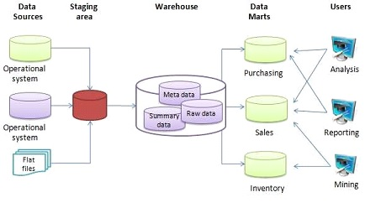
The Data Warehouse
Today (here at data weekender), it’s not important if the data warehouse is cloud based or on-premises. It’s also not important if we use Data Vault and/or Star Schema.
What matters – it’s centralized!
Image source: https://en.wikipedia.org/wiki/File:Data_warehouse_architecture.jpg

Slide 8
The Data Lake
Because not every data looks like a table, we started using a data lake:
A data lake is a system or repository of data stored in its natural/raw format, usually object blobs or files. A data lake is usually a single store of data including raw copies of source system data, sensor data, social data etc., and transformed data used for tasks such as reporting, visualization, advanced analytics and machine learning. A data lake can include structured data from relational databases (rows and columns), semi-structured data (CSV, logs, XML, JSON), unstructured data (emails, documents, PDFs) and binary data (images, audio, video). A data lake can be established "on premises" (within an organization's data centers) or "in the cloud" (using cloud services from vendors such as Amazon, Microsoft, or Google).
https://en.wikipedia.org/wiki/Data_lake

Slide 9
The Data Lake
Because not every data looks like a table, we started using a data lake:
A data lake is a synatural/raw format, usually object blobs or files. A data lake is usually a single store of data including raw copies of source system data, sensor data, social data etc., and transformed stem or repository of data stored in its data used for tasks such as reporting, visualization, advanced analytics and machine learning. A data lake can include structured data from relational databases (rows and columns), semi-structured data (CSV, logs, XML, JSON), unstructured data (emails, documents, PDFs) and binary data (images, audio, video). A data lake can be established "on premises" (within an organization's data centers) or "in the cloud" (using cloud services from vendors such as Amazon, Microsoft, or Google).
https://en.wikipedia.org/wiki/Data_lake

Slide 10
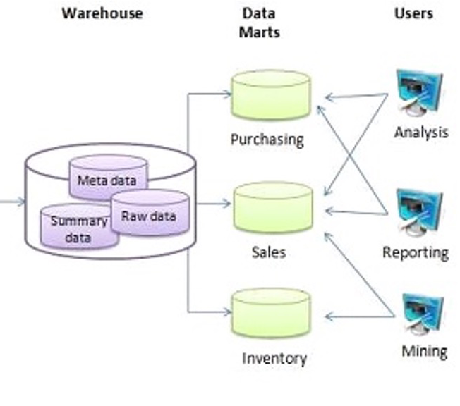
The Data Lake / The Data Warehouse
Is this a Déjà vu:
… transformed data used for tasks such as reporting, visualization, advanced analytics and machine learning. A data lake can include structured data from relational databases (rows and columns), …

Slide 11
And now - the Lakehouse (to safe us all?!)
The Lakehouse combines the benefits of the Data Warehouse and the Data Lake! (easy as that – really?!)
The Lakehouse combines the scalability and flexibility of the Data Lake with the performance and reliability of the Data Warehouse.
I consider one of the most important aspects of a Lakehouse architecture is the separation of compute and storage (and the storage format).

Slide 12




And now - the Lakehouse (a first glimpse into Fabric)
The Lakehouse combines the benefits of the Data Warehouse and the Data Lake!
Serverless
Compute
T-SQL
Spark
KQL
Analysis Services
the
Storage
called
OneLake
that is based on ADLS Gen2
Delta Table(s)

Slide 13
Data Mesh - a new architectural concept
Data mesh is a cultural and organizational shift for data management focusing on federation technology that emphasizes the authority of localized data management. Data mesh is intended to enable easily accessible data by the business. Data assets are analyzed for usage patterns by subject matter experts, who determine data affinity, and then the data assets are organized as data domains. Domains are contextualized with business context descriptors. Subject matter experts use the patterns and domains to define and create data products. Data products are registered and made available for reuse relative to business needs.
https://www.gartner.com/en/information-technology/glossary/data-mesh

Slide 14
Data Mesh - a new architectural concept
Data mesh is a cultural and organizational shift for data management focusing on federation technology that emphasizes the authority of localized data management. Data mesh is intended to enable easily accessible data by the business. Data assets are analyzed for usage patterns by subject matter experts, who determine data affinity, and then the data assets are organized as data domains. Domains are contextualized with business context descriptors. Subject matter experts use the patterns and domains to define and create data products. Data products are registered and made available for reuse relative to business needs.
https://www.gartner.com/en/information-technology/glossary/data-mesh

Slide 15
Data Mesh - a new architectural concept
Data mesh is a cultural and organizational shift for data management focusing on federation technology that emphasizes the authority of localized data management. Data mesh is intended to enable easily accessible data by the business. Data assets are analyzed for usage patterns by subject matter experts, who determine data affinity, and then the data assets are organized as data domains. Domains are contextualized with business context descriptors. Subject matter experts use the patterns and domains to define and create data products. Data products are registered and made available for reuse relative to business needs.
https://www.gartner.com/en/information-technology/glossary/data-mesh

Slide 16
Domains – (much) more than a tag
A domain, in the concept of a data mesh, refers to a specific area of expertise or responsibility within an organization. It represents a distinct business unit, team, or functional area that has ownership over its data products and related capabilities.
In a data mesh architecture, each domain is responsible for managing its own data products, including data collection, storage, processing, and analysis. Domains define data contracts, which specify the structure, quality, and usage of their data products, and provide APIs or interfaces for other domains to consume the data.
Domains within a data mesh are autonomous and self-contained, meaning they have the freedom to make decisions about their data products and the technologies they use. This allows for greater agility, scalability, and innovation within the organization.
By organizing data management and governance around domains, a data mesh promotes a decentralized approach to data architecture, enabling cross-functional collaboration, flexibility, and faster time-to-insights.

Slide 17
Domains – (much) more than a tag
A domain, in the concept of a data mesh, refers to a specific area of expertise or responsibility within an organization. It represents a distinct business unit, team, or functional area that has ownership over its data products and related capabilities.
In a data mesh architecture, each domain is responsible for managing its own data products, including data collection, storage, processing, and analysis. Domains define data contracts, which specify the structure, quality, and usage of their data products, and provide APIs or interfaces for other domains to consume the data.
Domains within a data mesh are autonomous and self-contained, meaning they have the freedom to make decisions about their data products and the technologies they use. This allows for greater agility, scalability, and innovation within the organization.
By organizing data management and governance around domains, a data mesh promotes a decentralized approach to data architecture, enabling cross-functional collaboration, flexibility, and faster time-to-insights.

Slide 18
Domains – (much) more than a tag
A domain, in the concept of a data mesh, refers to a specific area of expertise or responsibility within an organization. It represents a distinct business unit, team, or functional area that has ownership over its data products and related capabilities.
In a data mesh architecture, each domain is responsible for managing its own data products, including data collection, storage, processing, and analysis. Domains define data contracts, which specify the structure, quality, and usage of their data products, and provide APIs or interfaces for other domains to consume the data.
Domains within a data mesh are autonomous and self-contained, meaning they have the freedom to make decisions about their data products and the technologies they use. This allows for greater agility, scalability, and innovation within the organization.
By organizing data management and governance around domains, a data mesh promotes a decentralized approach to data architecture, enabling cross-functional collaboration, flexibility, and faster time-to-insights.

Slide 19
Data Product
A data product is an outcome that is generated from data analysis or processing. It can take various forms, such as conformed dimensions, shared datasets, reports, dashboards, visualizations, or predictive models.
Data products are designed to provide insights, support decision-making, and drive actions based on data.
In the context of a data mesh, each local data authority takes ownership of their data products. They define the structure, quality, and usage of their data products, and interfaces (maybe APIs) for other teams to reuse the data product.

Slide 20
Data Product
A data product is an outcome that is generated from data analysis or processing. It can take various forms, such as conformed dimensions, shared datasets, reports, dashboards, visualizations, or predictive models.
Data products are designed to provide insights, support decision-making, and drive actions based on data.
In the context of a data mesh, each local data authority takes ownership of their data products. They define the structure, quality, and usage of their data products, and interfaces (maybe APIs) for other teams to reuse the data product.

Slide 21
Data Product
A data product is an outcome that is generated from data analysis or processing. It can take various forms, such as conformed dimensions, shared datasets, reports, dashboards, visualizations, or predictive models.
Data products are designed to provide insights, support decision-making, and drive actions based on data.
In the context of a data mesh, each local data authority takes ownership (hopefully also responsibility and accountability) of their data products. They define the structure, quality, and usage of their data products, and interfaces (maybe APIs) for other teams to reuse the data product.

Slide 22
Data Products require Data Contracts because of
… In the context of a data mesh, each local data authority takes ownership of their data products. They define the structure, quality, and usage of their data products, and interfaces (maybe APIs) for other teams to reuse the data product.
A data contract is a specification or agreement that outlines the structure, quality, and usage of a data product within a data mesh framework. It defines the requirements for the data, including its format, schema, metadata, and any constraints or rules associated with it.
The data contract serves as a guideline for other teams or consumers who want to access and use the data product. It provides clarity on how the data should be interpreted, consumed, and integrated into their own processes or applications.

Slide 23
Data Contract - template Validate carefully, use at your own risk
Data Product Name:
[Specify the name or identifier of the data product]
Data Product Description:
[Provide a brief description of the data product, including its purpose and intended use]
Data Structure:
[Describe the structure of the data product, including the format, schema, and any relevant metadata]
Data Quality Requirements:
[Specify the quality requirements for the data product, such as accuracy, completeness, and timeliness]
Data Usage Guidelines:
[Define how the data product should be used, including any restrictions or guidelines for access and consumption]
Data Contracts and APIs:
[Specify any data contracts or APIs provided by the data product, including the methods and interfaces for accessing and interacting with the data]
Data Ownership and Responsibility:
[Identify the team or domain responsible for the data product and any associated data management tasks]
Data Governance and Security:
[Outline the governance and security measures in place for the data product, including data privacy, access controls, and compliance requirements]
Data Product Lifecycle:
[Describe the lifecycle of the data product, including data collection, processing, storage, and archiving]
Data Product Dependencies:
[Identify any dependencies or relationships with other data products or systems]
Data Product Updates and Maintenance:
[Explain how updates and maintenance of the data product will be handled, including versioning, documentation, and change management processes]

Slide 24
Data Contract - template Validate carefully, use at your own risk
Data Product Name:
[Specify the name or identifier of the data product]
Data Product Description:
[Provide a brief description of the data product, including its purpose and intended use]
Data Structure:
[Describe the structure of the data product, including the format, schema, and any relevant metadata]
Data Quality Requirements:
[Specify the quality requirements for the data product, such as accuracy, completeness, and timeliness]
Data Usage Guidelines:
[Define how the data product should be used, including any restrictions or guidelines for access and consumption]
Data Contracts and APIs and delta tables:
[Specify any data contracts or APIs or delta tables provided by the data product, including the methods and interfaces for accessing and interacting with the data]
Data Ownership and Responsibility:
[Identify the team or domain responsible for the data product and any associated data management tasks]
Data Governance and Security:
[Outline the governance and security measures in place for the data product, including data privacy, access controls, and compliance requirements]
Data Product Lifecycle:
[Describe the lifecycle of the data product, including data collection, processing, storage, and archiving]
Data Product Dependencies:
[Identify any dependencies or relationships with other data products or systems]
Data Product Updates and Maintenance:
[Explain how updates and maintenance of the data product will be handled, including versioning, documentation, and change management processes]

Slide 25
Data Mesh - a new architectural concept vs the Data Warehouse
Data mesh is a cultural and organizational shift for data management focusing on federation technology that emphasizes the authority of localized data management. …
In computing, a data warehouse (DW or DWH), also known as an enterprise data warehouse (EDW), is a system used for reporting and data analysis and is considered a core component of business intelligence. Data warehouses are central repositories of integrated data …

Slide 26
Excel, Access, SQL Server, Synapse, or Fabric – what to use?
As always it depends …
If you store your most precious data in an Excel file, Fabric is not for you
If you are considering to implement a Warehouse, rethink and consider creating a Lakehouse
If you feel better with a relational engine, rethink: if you still want a relational engine at the core of your precious data use Synapse
Be aware that you can start small with Fabric, not only in the sense of capacity size

Slide 27
Data Mesh, is this the concept to implement?
As always it depends …
Federated teams, means “skilled federated teams”:
How large is your data organization?

Slide 28
Data Mesh, is this the concept to implement?
As always it depends …
Federated teams, means “skilled federated teams”:
How large is your data organization?
How data literate is your data organization: Saying Pie charts are evil is not enough!

Slide 29
Data Mesh, is this the concept to implement?
As always it depends …
Federated teams, means “skilled federated teams”:
How large is your data organization?
How data literate is your data organization: Saying Pie charts are evil is not enough!
Be prepared for “good enough data quality” discussions!

Slide 30
Data Mesh, is this the concept to implement?
As always it depends …
Federated teams, means “skilled federated teams”:
How large is your data organization?
How data literate is your data organization: Saying Pie charts are evil is not enough!
Be prepared for “good enough data quality” discussions!
Be prepared for “Oooppsy emails” telling you that the data does not refresh as expected

Slide 31
Data Mesh, is this the concept to implement?
As always it depends …
Federated teams, means “skilled federated teams”:
How large is your data organization?
How data literate is your data organization: Saying Pie charts are evil is not enough!
Be prepared for “good enough data quality” discussions!
Be prepared for “Oooppsy emails” telling you that the data did not refresh as expected
If you think you will benefit largely from data products, implementing the Data Mesh concept will be a game changer, but be prepared for “fight for talents” in your organization, this must be handled.

Slide 32

Now some Fabric

Slide 33

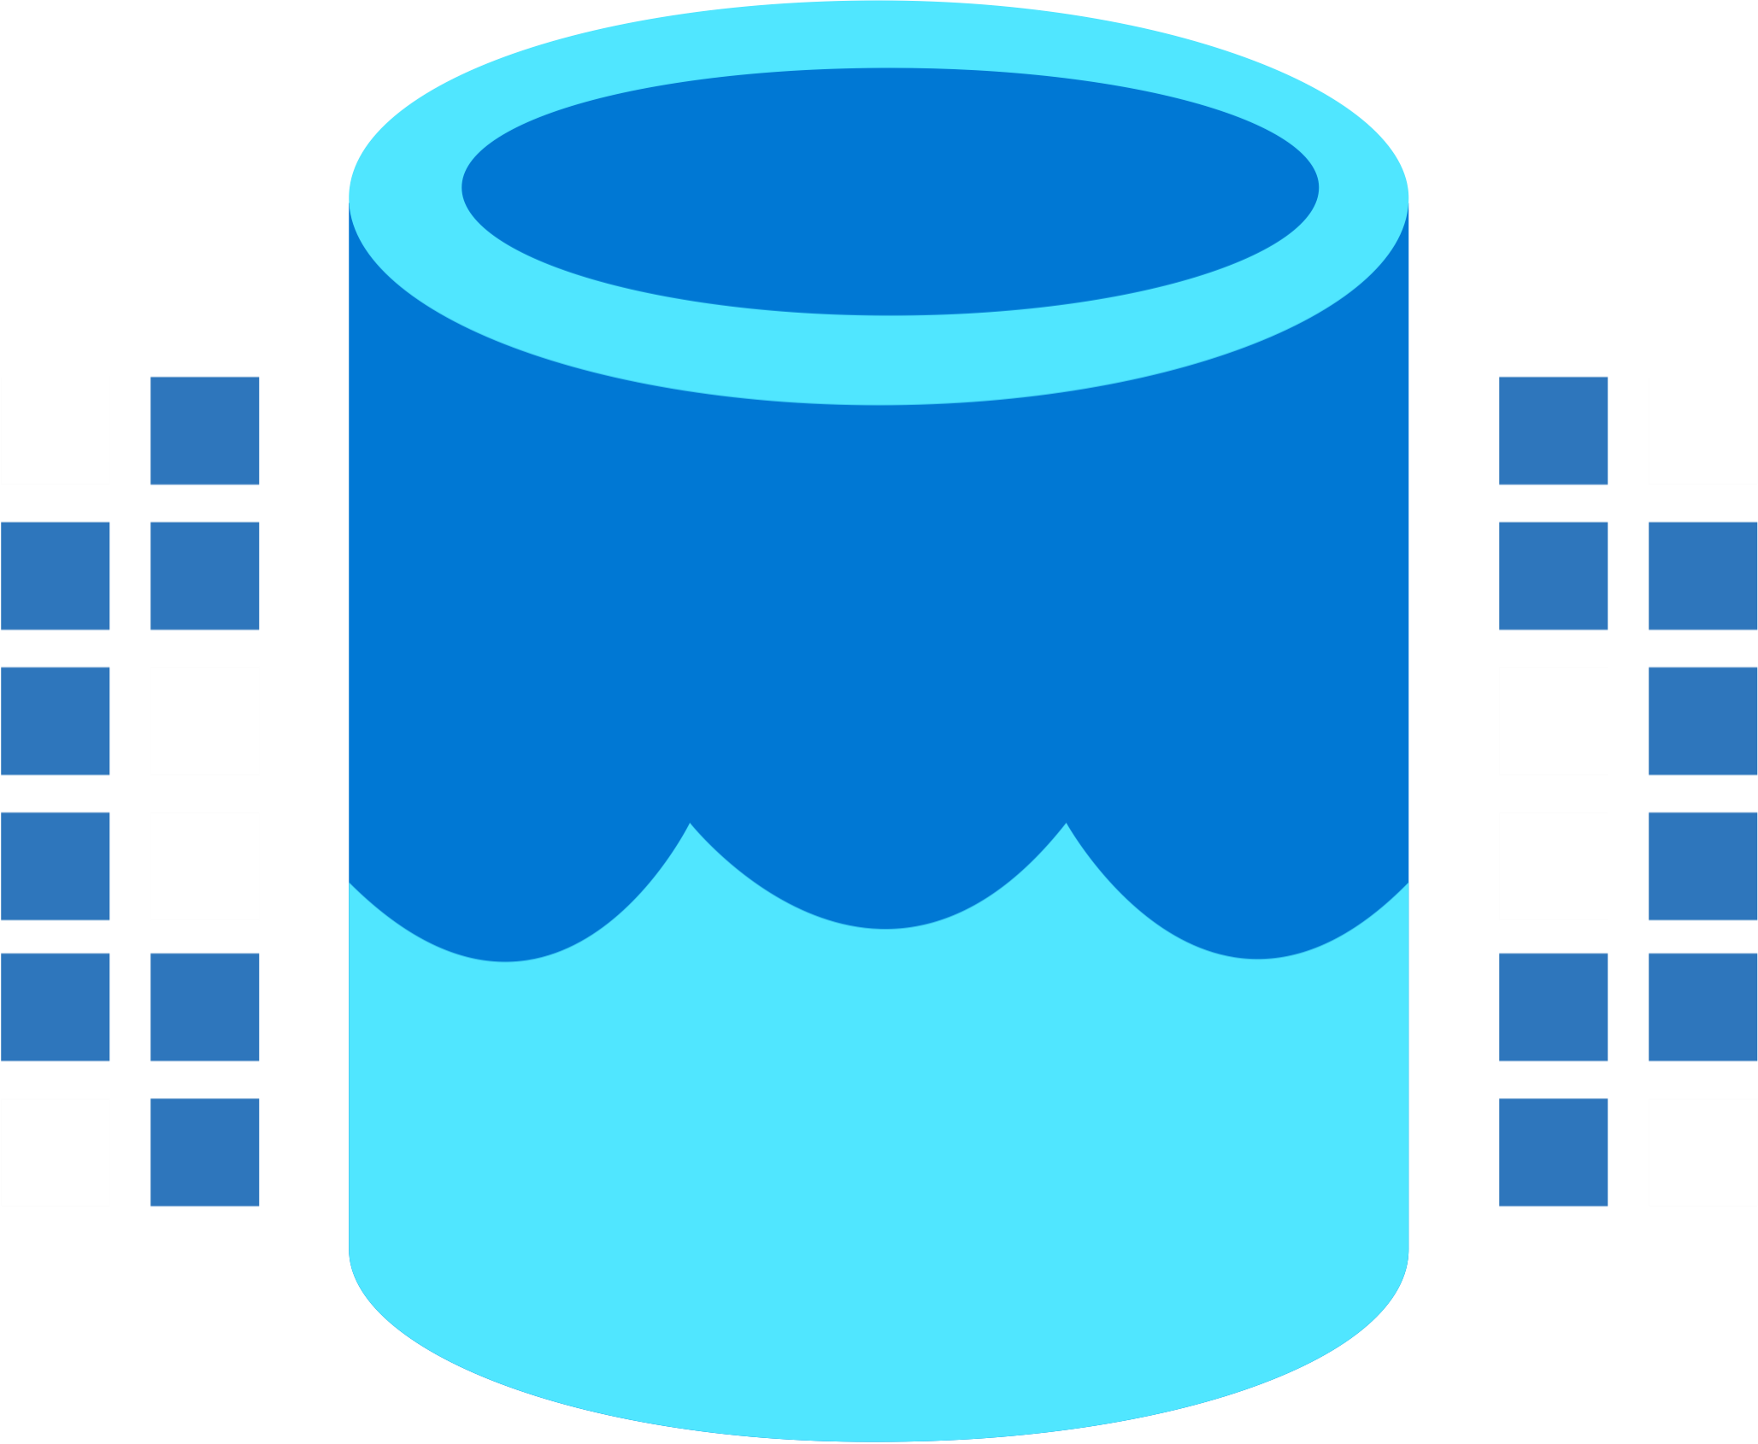
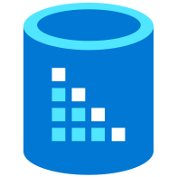

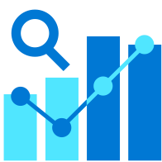




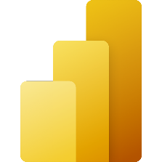



Microsoft Fabric
Data Integration
Data Lake
Spark Engines
Data
Warehouse
Real Time Analytics
Data
Science
Business
Intelligence
Governance
Data Factory
Kusto
Azure AI
Power BI
Spark
Synapse
Purview
Unified analytics fabric
End-to-end analytics data fabric
From the data lake to the business user
Notes:
Today, with Microsoft Fabric, we go from a collection of products to a Unified Analytics fabric that brings end-to-end analytics from the data lake to the business user

Slide 34


Data Mesh - a new architectural concept
Data mesh is a cultural and organizational shift for data management focusing on federation technology that emphasizes the authority of localized data management. …
… located in an Azure Region
A Fabric workspace (when it’s backed by a Premium or Fabric capacity) provides all the necessary compute and storage to a federated data team to build their data product(s)!
Some workspaces assigned to a Fabric Capacity …
A Power BI workspace

Slide 35
Data Mesh - a new architectural concept
Data mesh is a cultural and organizational shift for data management focusing on federation technology that emphasizes the authority of localized data management. …
… located in a different Azure Region
Some workspaces assigned to a Fabric Capacity …
A Power BI workspace

Slide 36

Data Mesh - a new architectural concept
In the context of a data mesh, each local data authority takes ownership of their data products. They define the structure, quality, and usage of their data products, and interfaces (maybe APIs) for other teams to reuse the data product.
… located in a different Azure Region
Some workspaces assigned to a Fabric Capacity …
Shortcut
A Power BI workspace

Slide 37

And now, what?
If you are in analytics, consider using Fabric.
Be aware it’s currently in preview (but this might change soon).

Slide 38
Thank you

